Slide 2
The Ode of Onesimus

Slide 3
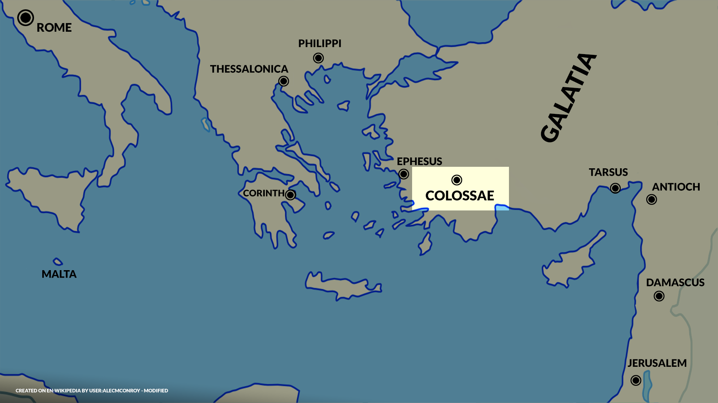

Slide 4
The Ode of Onesimus

Slide 5
The Ode of Onesimus

Slide 6
Profiling Philemon

Slide 7
You’ve got to be ‘Plugged In’ to ‘Push On’

