Slide 1
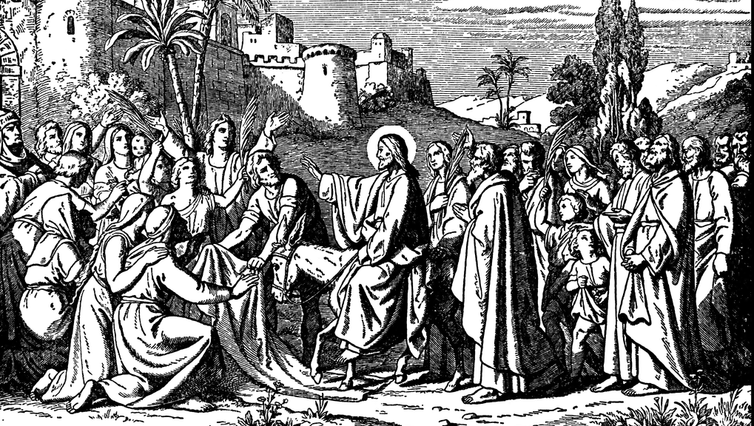


The Triumph of Grace
The GOSPEL OF MATTHEW

Slide 2

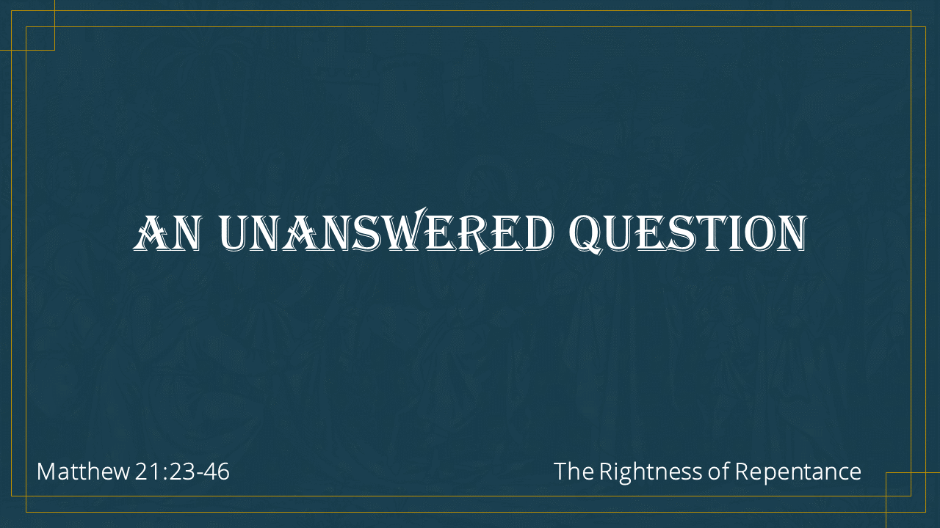
An unanswered question
Matthew 21:23-46
The Rightness of Repentance

Slide 3
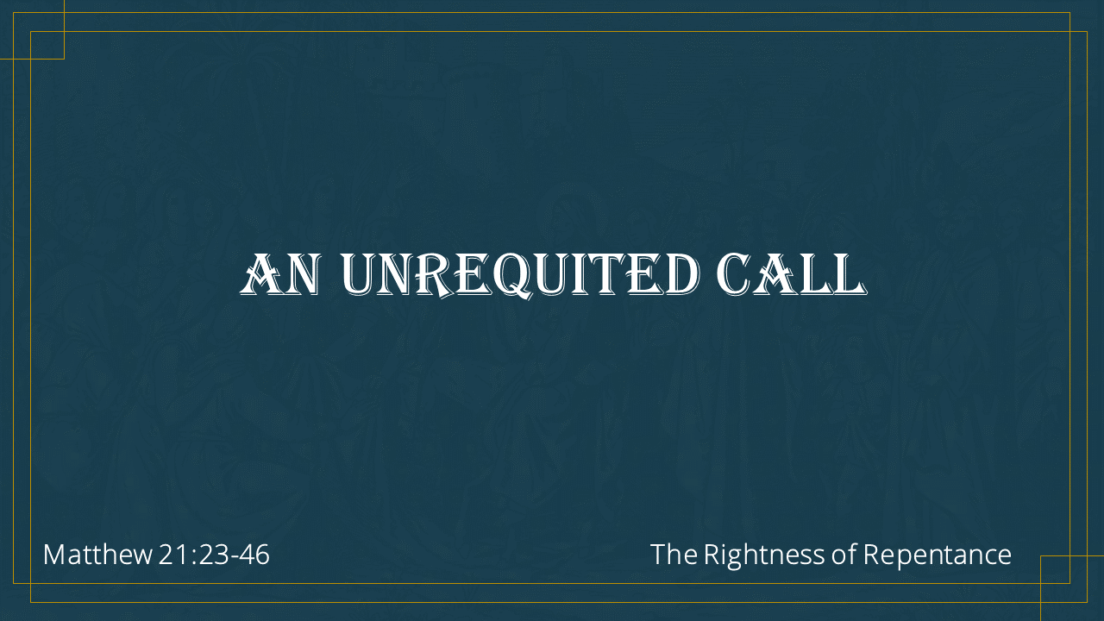
An unrequited call
Matthew 21:23-46
The Rightness of Repentance

Slide 4
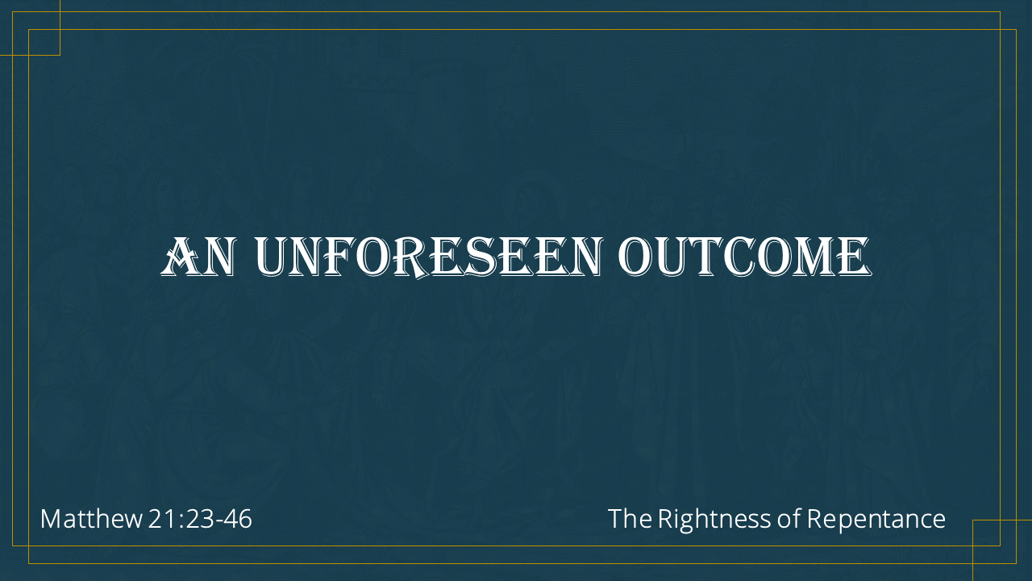
An Unforeseen OUTCOME
Matthew 21:23-46
The Rightness of Repentance

