Slide 1
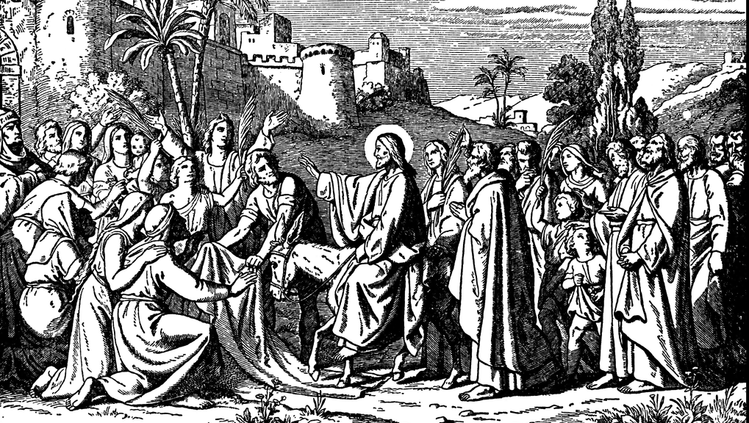


The Triumph of Grace
The GOSPEL OF MATTHEW

Slide 2



Slide 3
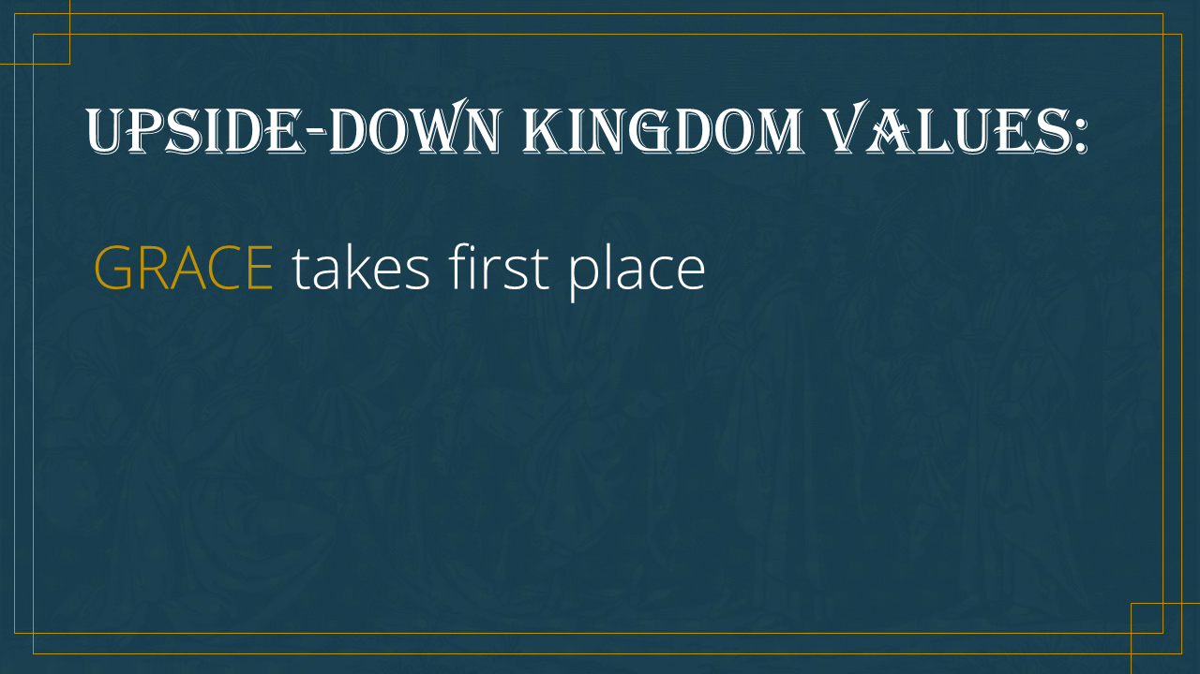

Slide 4
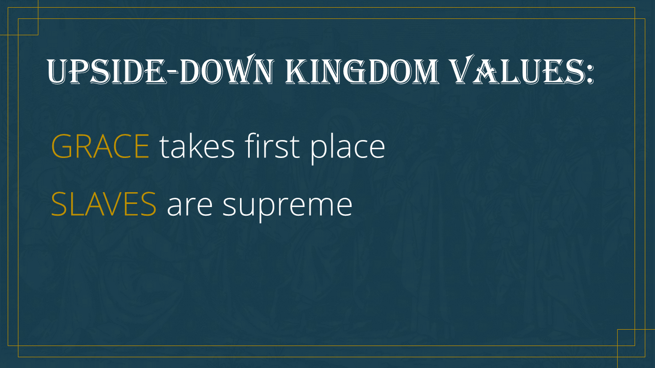

Slide 5
The Triumph of Grace
The GOSPEL OF MATTHEW

