Slide 1
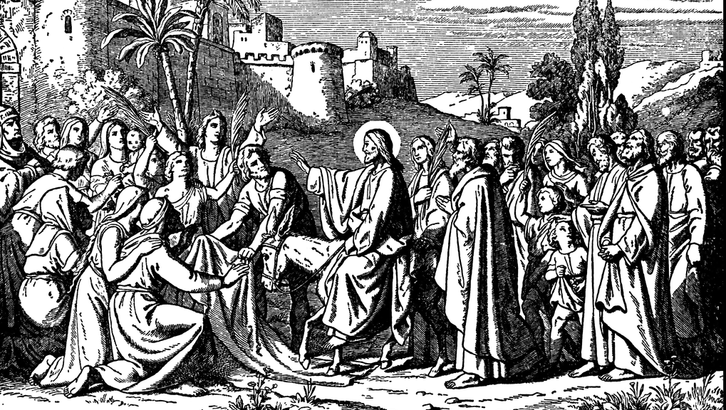


The Triumph of Grace
The GOSPEL OF MATTHEW

Slide 2
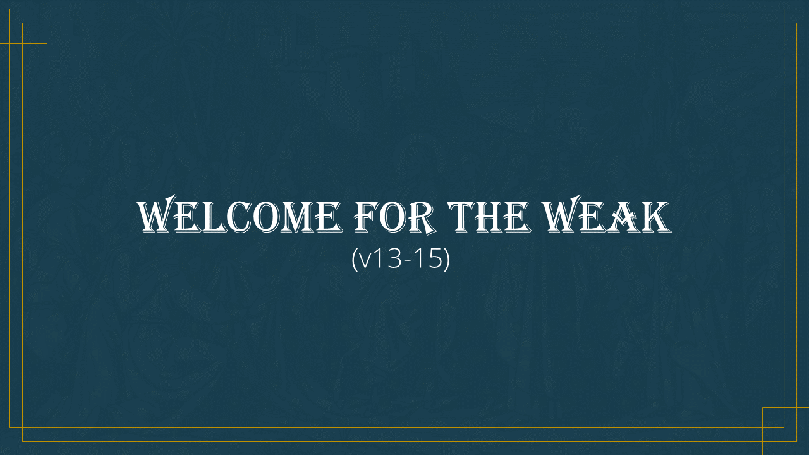

Welcome for the weak
(v13-15)

Slide 3
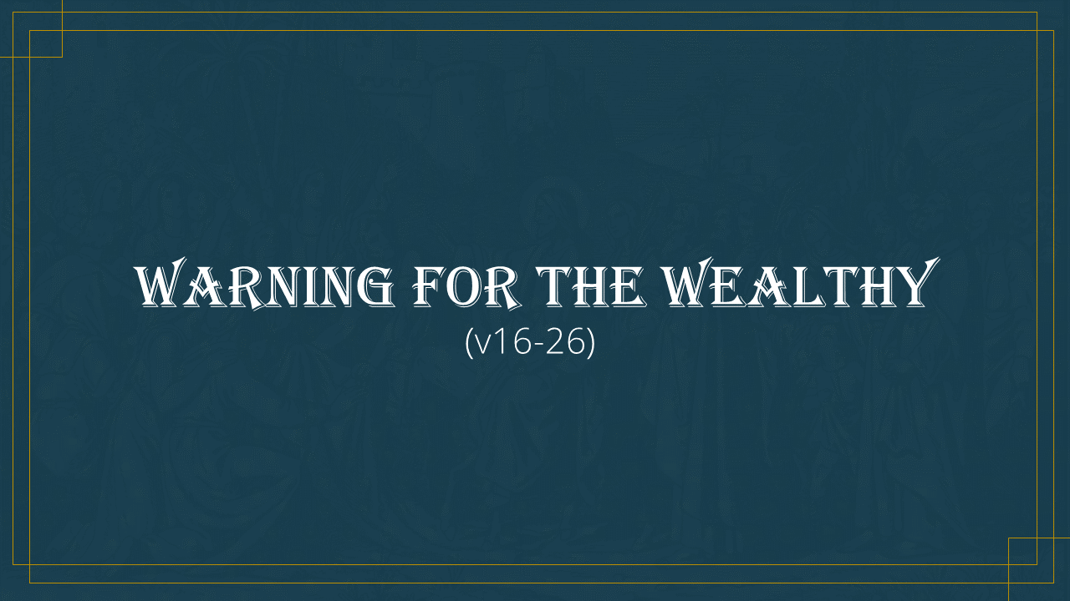
Warning for the wealthy
(v16-26)

Slide 4

A Word for the workers
(v27-30)

