Slide 1


Slide 2
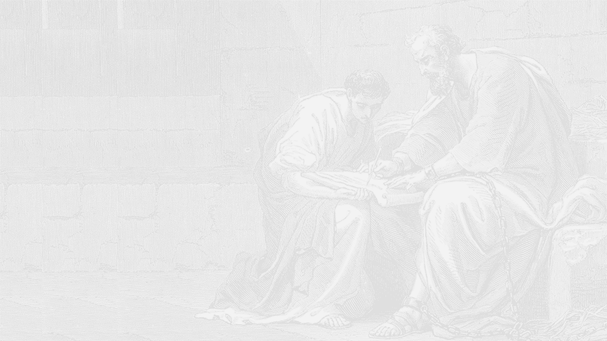
Here’s the Main Point:
BE RECONCILED

Slide 3
Is Reconciliation Enough?
- a note on slavery

Slide 4
The Rewards of Reconciliation

