Slide 1
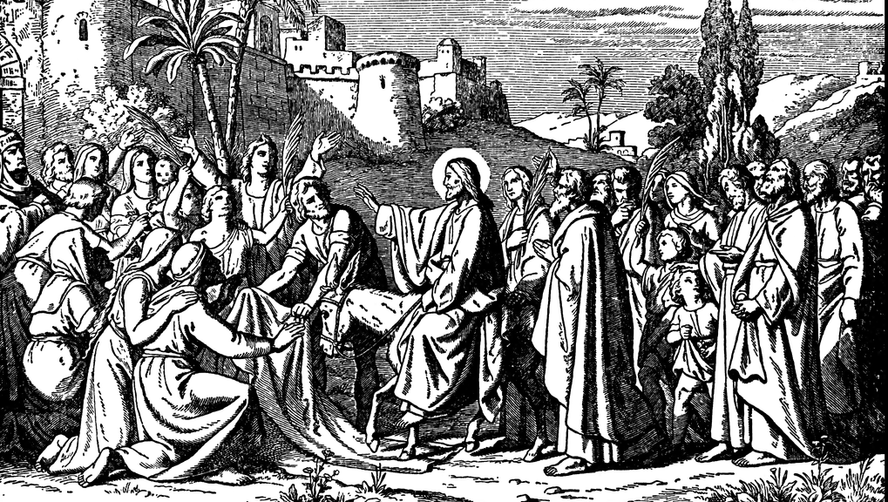
The Triumph of Grace
The GOSPEL OF MATTHEW

Slide 2
3 Questions: 1 Age
Matthew 24:1-51
The Last Speech on the Last Times

Slide 3
JESUS KNOWS WHAT’S COMING…
…SO TRUST HIM
Matthew 24:1-51
The Last Speech on the Last Times

Slide 4
JESUS IS COMING BACK…
…SO BE WARNED
Matthew 24:1-51
The Last Speech on the Last Times

Slide 5
JESUS IS COMING BACK…
…SO BE READY
Matthew 24:1-51
The Last Speech on the Last Times

Slide 6
The Triumph of Grace
The GOSPEL OF MATTHEW

