Slide 1
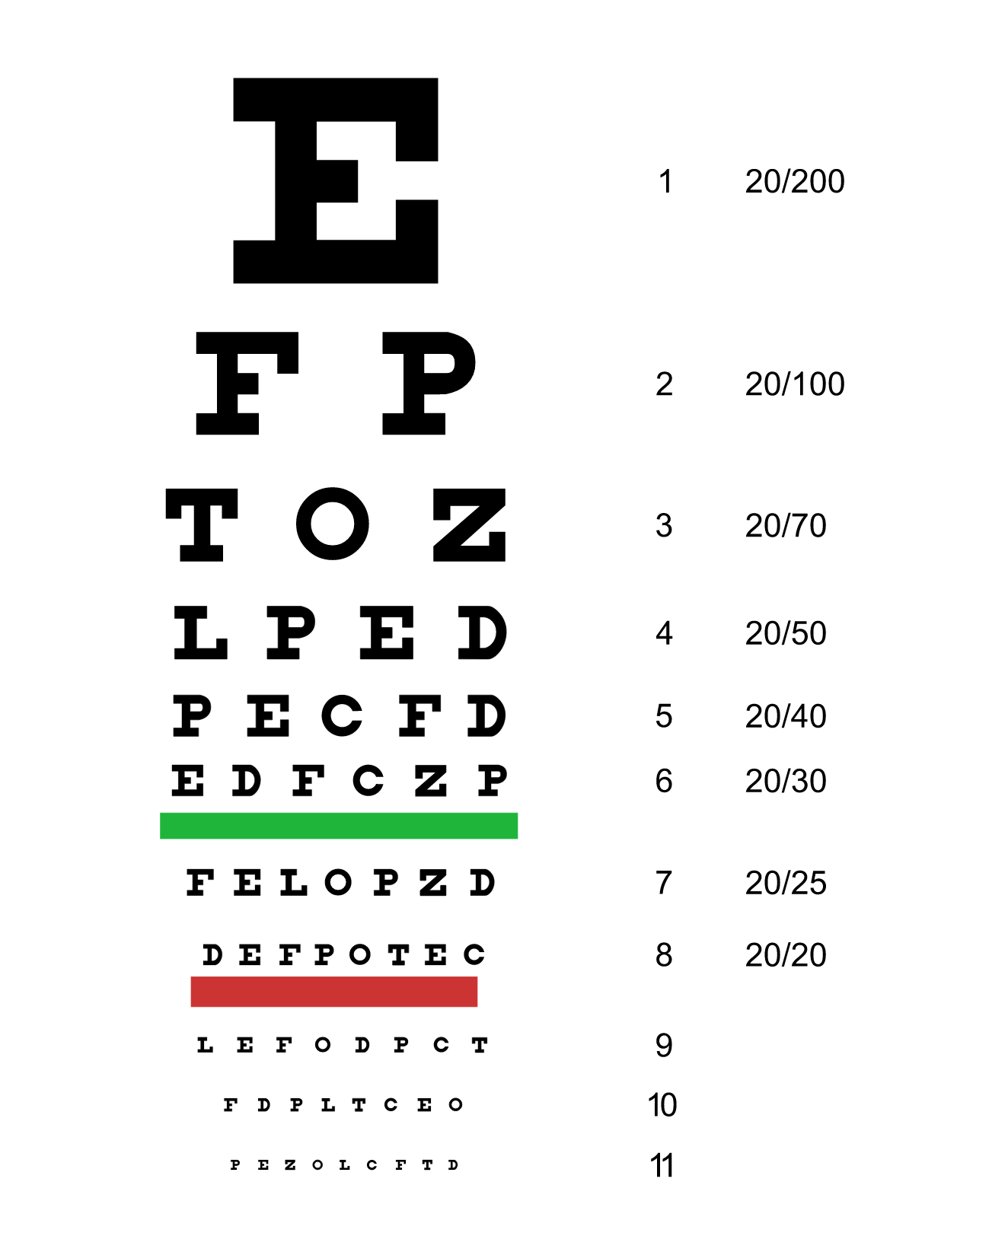
20/20
20/20
20/20
2 Corinthians 12:1-10

Slide 3
Thorn in the Flesh

Slide 4
σκολοψ
‘skolops’
Sharp Stick
Stake

Slide 6
Purpose in Our Pain

Slide 8
“It doesn’t matter who or what gets hurt in the process… Genes don’t care about suffering, because they don’t care about anything… Nature is neither kind nor unkind. She is neither against suffering nor for it. It only matters as it affects the survival of DNA.”
Prof. Richard Dawkins

Slide 10
“Whoever wants to be my disciple must deny themselves, take up their cross and follow me.”
Mark 8:34

Slide 12
For He is our child-hood's pattern,
Day by day like us He grew,
He was little, weak, and helpless,
Tears and smiles like us He knew,
And He feels for our sadness,
And He shares in our gladness.
Once in Royal David’s City

Slide 14
ESV v.7
So to keep me from becoming conceited because of the surpassing greatness of the revelations, a thorn was given me in the flesh, a messenger of Satan to harass me, to keep me from becoming conceited.

Slide 15
ESV v.7
So to keep me from becoming conceited because of the surpassing greatness of the revelations, a thorn was given me in the flesh, a messenger of Satan to harass me, to keep me from becoming conceited.

Slide 17
Power in Our Weakness

Slide 19
Power in Our Weakness

Slide 22
“Consider it pure joy, my brothers and sisters, whenever you face trials of many kinds, because you know that the testing of your faith produces perseverance. Let perseverance finish its work so that you may be mature and complete, not lacking anything.”
James 1:2-4

Slide 23
20/20
20/20
20/20
2 Corinthians 12:1-10

