Slide 1


Slide 2
Introduction – when is church best?
How good and pleasant it is when brothers live together in unity (v.1)
Pause:
What is unity?
What does it look like?

Slide 3
Introduction – when is church best?
How good and pleasant it is when brothers live together in unity (v.1)
Unity is right

Slide 4
Introduction – when is church best?
How good and pleasant it is when brothers live together in unity (v.1)
Unity is right
Unity feels right

Slide 5
When brothers live together in unity
Unity is right
Unity feels right
Two pictures:
Oil running down the beard
Dew on Mt Hermon

Slide 6
When brothers live together in unity
²² Then the LORD said to Moses,
²³ "Take the following fine spices: 500 shekels of liquid myrrh, half as much (that is, 250 shekels) of fragrant cinnamon, 250 shekels of fragrant cane, ²⁴ 500 shekels of cassia--all according to the sanctuary shekel--and a hin of olive oil. ²⁵ Make these into a sacred anointing oil, a fragrant blend, the work of a perfumer. It will be the sacred anointing oil.
²⁶ Then use it to anoint the Tent of Meeting, the ark of the Testimony… ²⁹ You shall consecrate them so they will be most holy, and whatever touches them will be holy.
³⁰ "Anoint Aaron and his sons and consecrate them so they may serve me as priests. ³¹ Say to the Israelites, `This is to be my sacred anointing oil for the generations to come. ³² Do not pour it on men's bodies and do not make any oil with the same formula. It is sacred, and you are to consider it sacred.” (Exodus 30:22-33)

Slide 7
When brothers live together in unity
²² Then the LORD said to Moses,
²³ "Take the following fine spices: 500 shekels of liquid myrrh, half as much (that is, 250 shekels) of fragrant cinnamon, 250 shekels of fragrant cane, ²⁴ 500 shekels of cassia--all according to the sanctuary shekel--and a hin of olive oil. ²⁵ Make these into a sacred anointing oil, a fragrant blend, the work of a perfumer. It will be the sacred anointing oil.
²⁶ Then use it to anoint the Tent of Meeting, the ark of the Testimony… ²⁹ You shall consecrate them so they will be most holy, and whatever touches them will be holy.
³⁰ "Anoint Aaron and his sons and consecrate them so they may serve me as priests. ³¹ Say to the Israelites, `This is to be my sacred anointing oil for the generations to come. ³² Do not pour it on men's bodies and do not make any oil with the same formula. It is sacred, and you are to consider it sacred.” (Exodus 30:22-33)

Slide 8
When brothers live together in unity
Unity is right
Unity feels right
Two pictures:
Oil: Unity is sacred, precious, fragrant
Dew on Mt Hermon

Slide 9
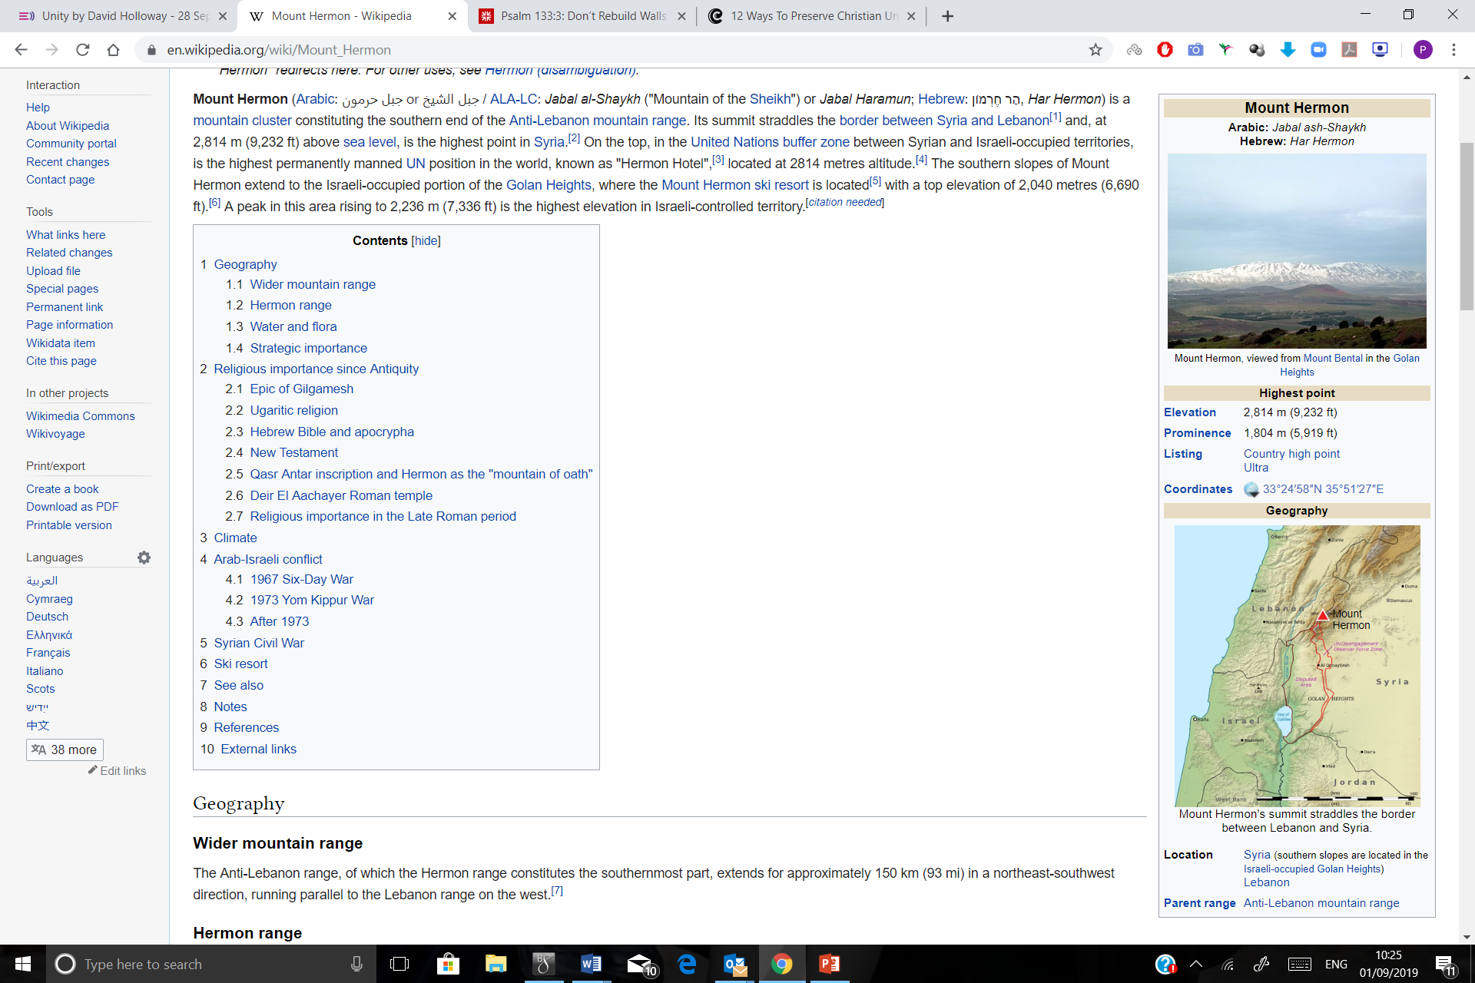
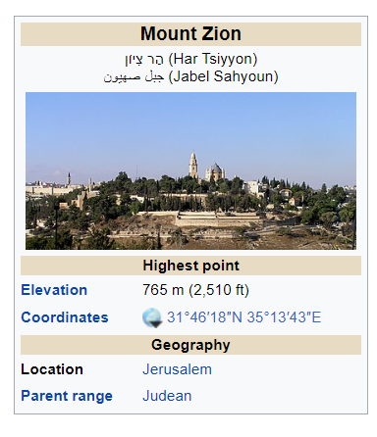
Mount Zion

Slide 10
When brothers live together in unity
Unity is right
Unity feels right
Two pictures:
Oil: Unity is sacred, precious, fragrant
Dew: Unity is supernatural, brings life

Slide 11
When brothers live together in unity
Unity is right, feels right
Unity is sacred, precious, fragrant, supernatural, life bringing
Unity is found only in Zion

Slide 12
When brothers live together in unity
Unity is right, feels right
Unity is sacred, precious, fragrant, supernatural, life bringing
Unity is found only in Zion: Christ

Slide 13
When brothers live together in unity
Unity is right, feels right
Unity is sacred, precious, fragrant, supernatural, life bringing
Unity is found only in Christ
  Jesus defines our unity
  Jesus prays for our unity
  Jesus empowers us for unity

Slide 14
When brothers live together in unity
  “As a prisoner for the Lord, then, I urge you to live a life worthy of the calling you have received. ² Be completely humble and gentle; be patient, bearing with one another in love. ³ Make every effort to keep the unity of the Spirit through the bond of peace.” (Ephesians 4:1-3)

Slide 15
When brothers live together in unity
Unity is right, feels right
Unity is sacred, precious, fragrant, supernatural, life bringing
Unity is found only in Christ
So, Praise the LORD, all…! (Ps. 134)

