Slide 1


Slide 2
#blessed

Slide 3


Slide 4


Slide 5


Slide 6


Slide 7


Slide 8
#blessed

Slide 9
#blessed
Blessing is a reality
Blessing has a condition
Blessing needs a rethink

Slide 10
Blessing is a reality

Slide 11
Blessing is a reality
Fulfilling work
General happiness and wealth
Fertility
Good economy
Long life and health
Peace

Slide 12
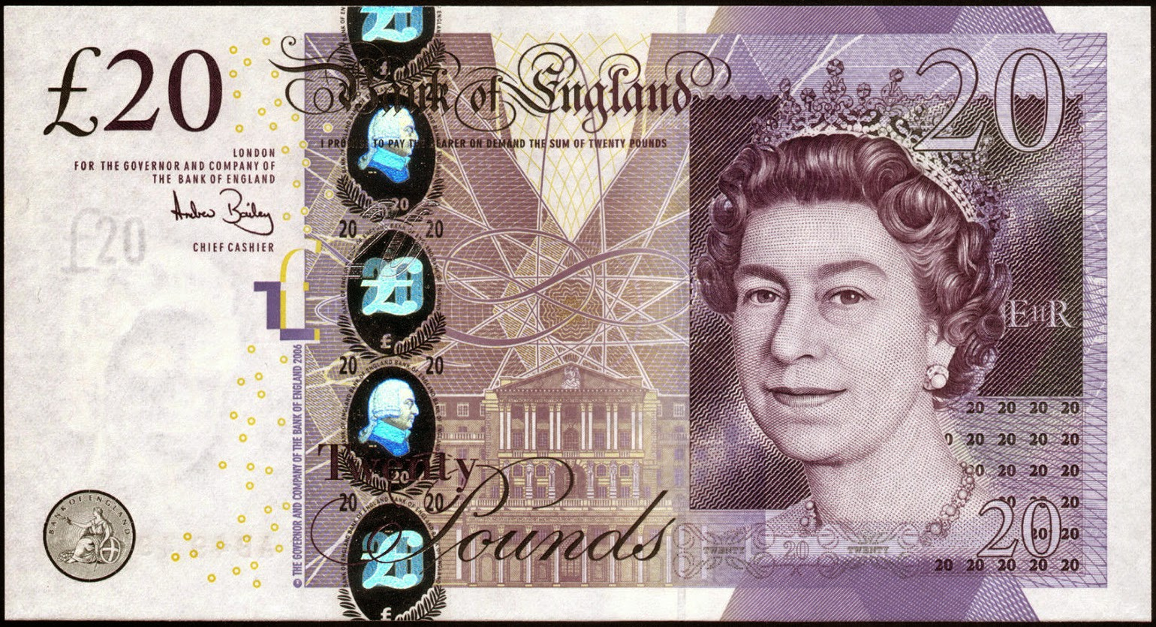
Blessing is a reality

Slide 13
Blessing is a reality
Earned
Chance
Gift

Slide 14
Blessing is a reality
Earned
God
Chance
Gift

Slide 15
Blessing has a condition

Slide 16
Blessing has a condition
The fear of the Lord is the appropriate attitude towards God in light of his character that leads to obedience.

Slide 17
Blessing has a condition
These are the ones I look on with favour, those who are humble and contrite in spirit, and who tremble at my word.
Isaiah 66:2

Slide 18
Blessing has a condition
…work out your salvation with fear and trembling
Philippians 2:12

Slide 19
Blessing has a condition
Lord, let your ear be attentive to the prayer of this your servant and to the prayer of your servants who delight in revering your name.
Nehemiah 1:11

Slide 20
Blessing has a condition
The fear of the Lord is the appropriate attitude towards God in light of his character that leads to obedience.

Slide 21
Blessing needs a rethink

Slide 22
Blessing needs a rethink
We think we know best
And we know that in all things God works for the good of those who love him…
Romans 8:28

Slide 23
Blessing needs a rethink
We think we know best
We obsess over appearance

Slide 24
Blessing needs a rethink
We think we know best
We obsess over appearance
We focus too much on now

Slide 25
Blessing needs a rethink
Fulfilling work
Happiness/wealth
Fertility
Long life, health
Good economy/ peace
Little impact
Homeless & hated
Childless
Short life
Oppression of Israel

Slide 26
Blessing needs a rethink
Fulfilling work
Happiness/wealth
Fertility
Long life, health
Good economy/ peace
Profound impact
Homeless & hated
Childless
Short life
Oppression of Israel

Slide 27
Blessing needs a rethink
Fulfilling work
Happiness/wealth
Fertility
Long life, health
Good economy/ peace
Profound impact
Right hand of God
Childless
Short life
Oppression of Israel

Slide 28
Blessing needs a rethink
Fulfilling work
Happiness/wealth
Fertility
Long life, health
Good economy/ peace
Profound impact
Right hand of God
Billions of children
Short life
Oppression of Israel

Slide 29
Blessing needs a rethink
Fulfilling work
Happiness/wealth
Fertility
Long life, health
Good economy/ peace
Profound impact
Right hand of God
Billions of children
Eternal life
Oppression of Israel

Slide 30
Blessing needs a rethink
Fulfilling work
Happiness/wealth
Fertility
Long life, health
Good economy/ peace
Profound impact
Right hand of God
Billions of children
Eternal life
Peace in the New Jerusalem

Slide 31
Blessing needs a rethink
The time has come for judging the dead, and for rewarding your servants the prophets and your people who revere your name, both great and small.
Revelation 11:18

