Slide 1
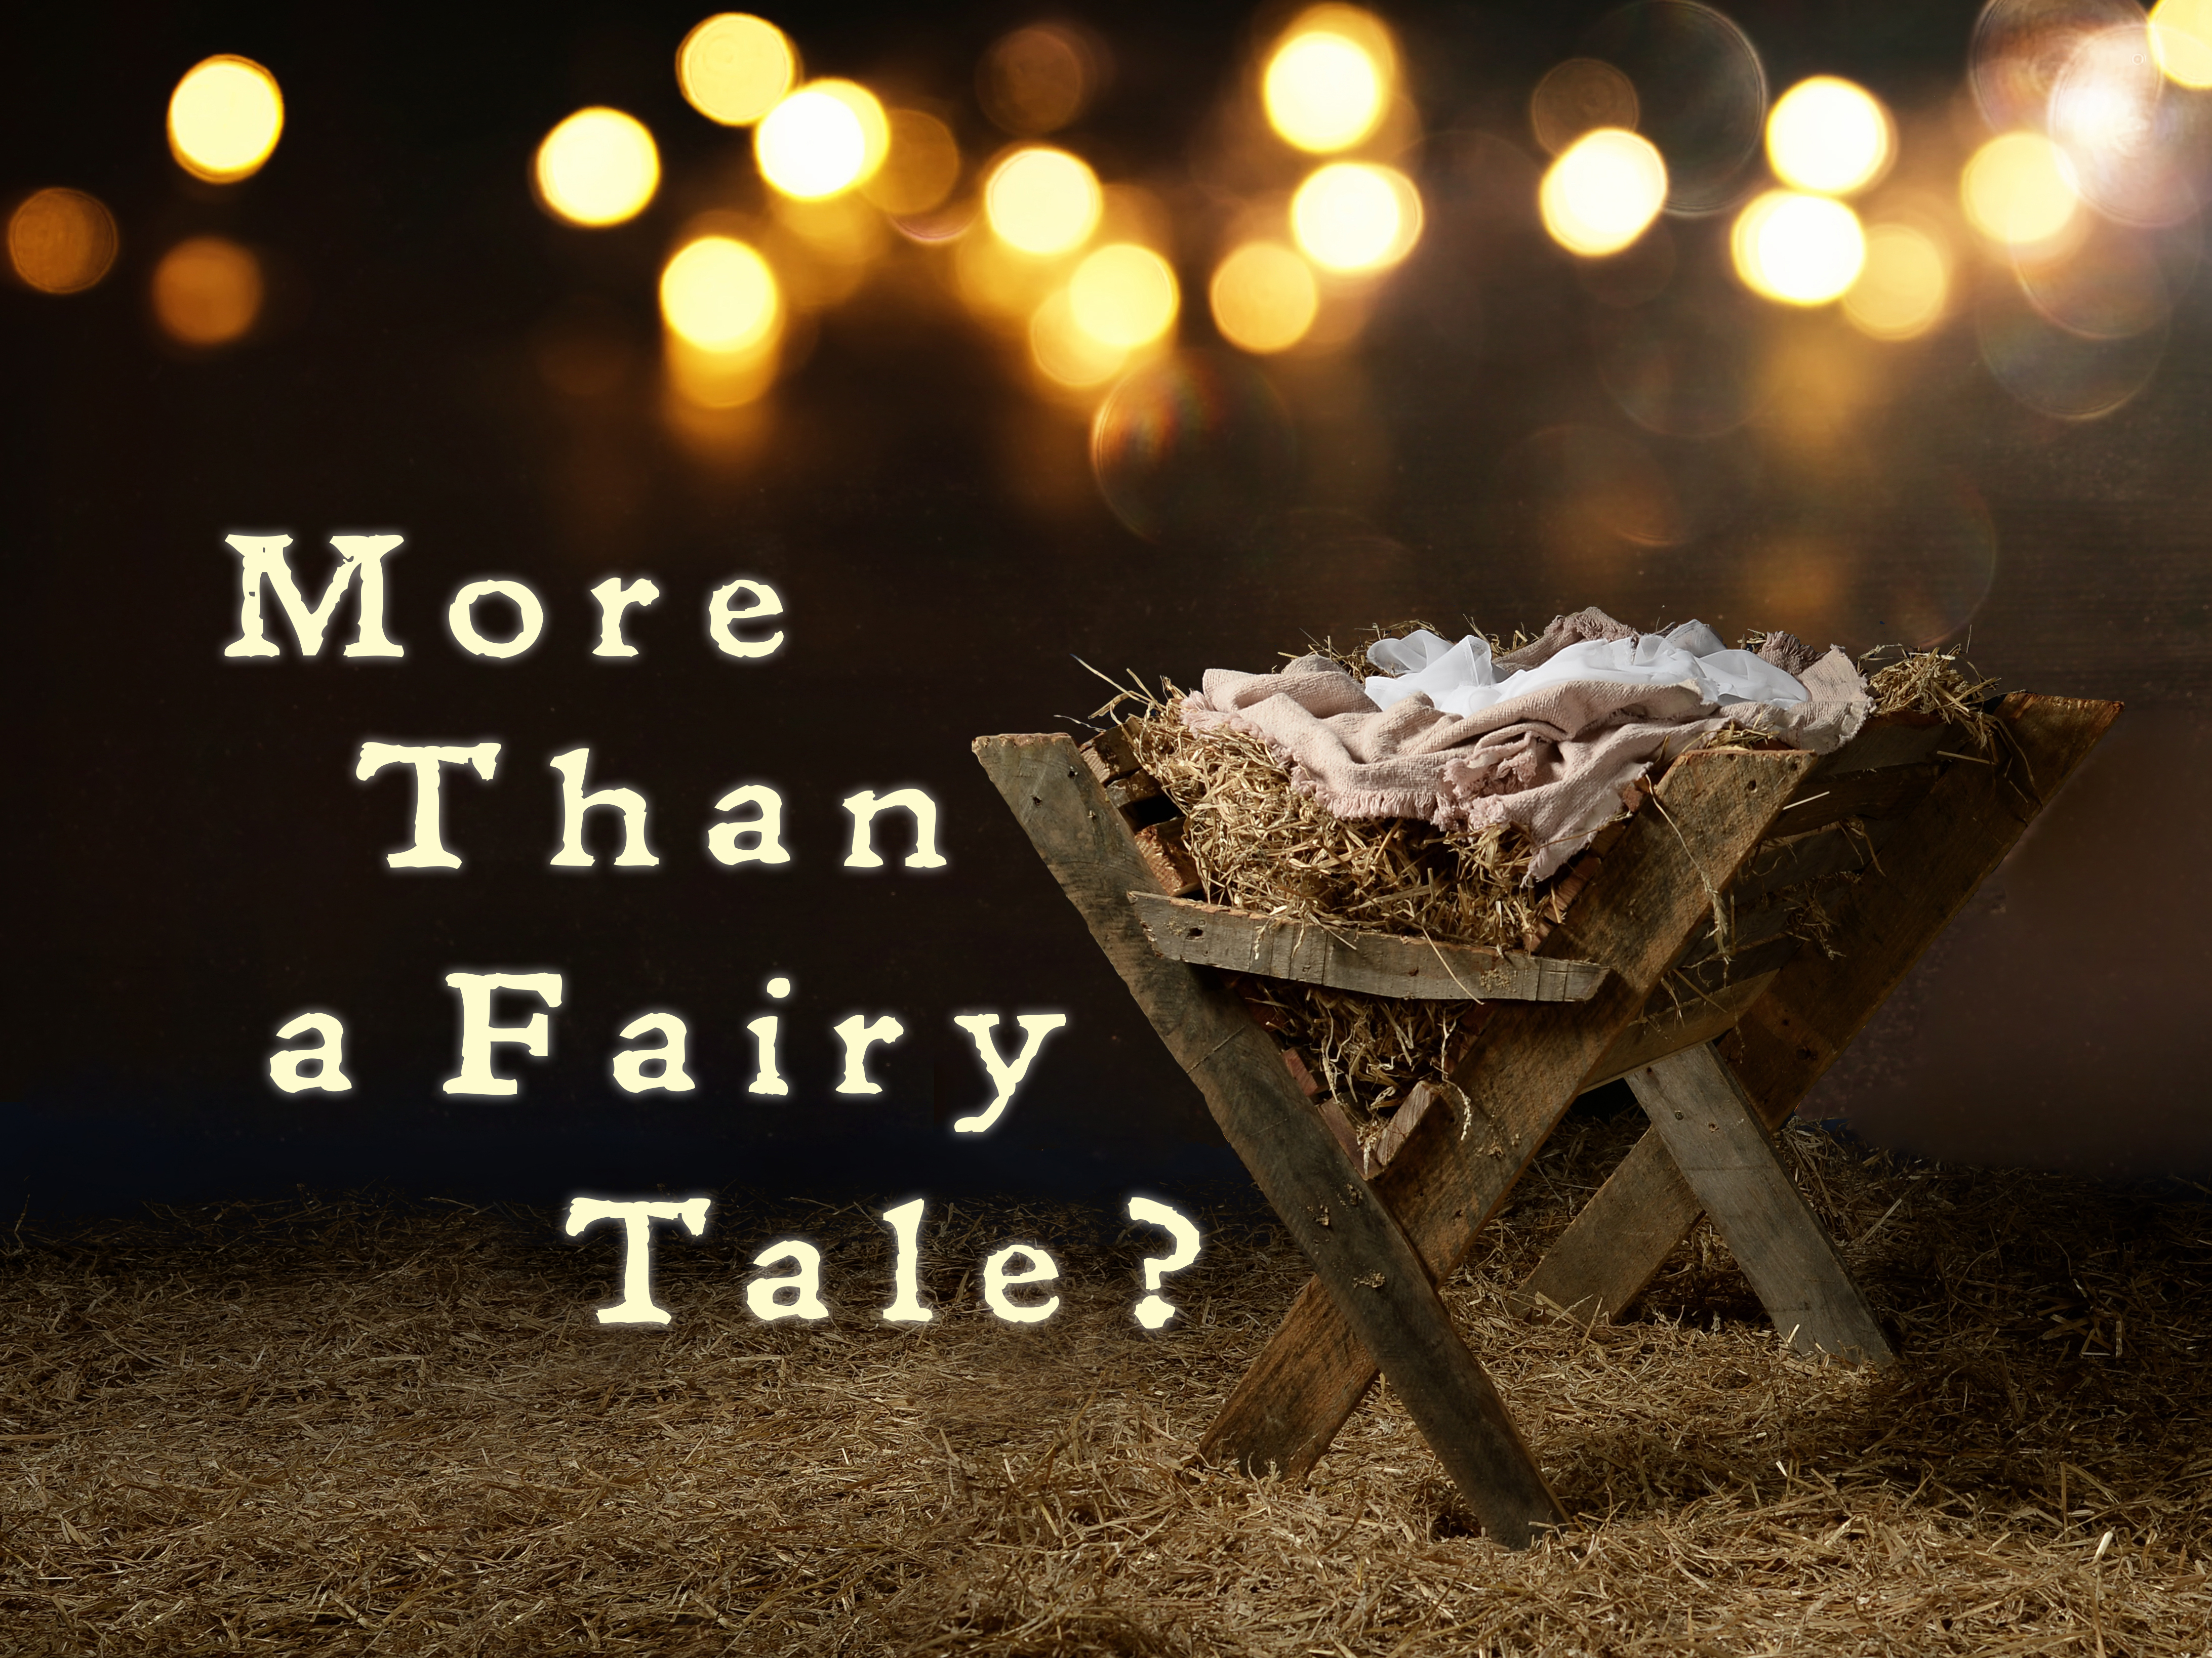

Slide 2
The Christmas Story
True?
Good?
Beautiful?

Slide 3
“Creatures are not born with desires unless satisfaction for those desires exists. A baby feels hunger: well, there is such thing as food. A duckling wants to swim: well, there is such a thing as water. [Humans] feel sexual desire: well, there is such a thing as sex. If I find a desire which no experience in this world can satisfy, the most probable explanation is that I was made for another world.”
– C.S. Lewis

Slide 4
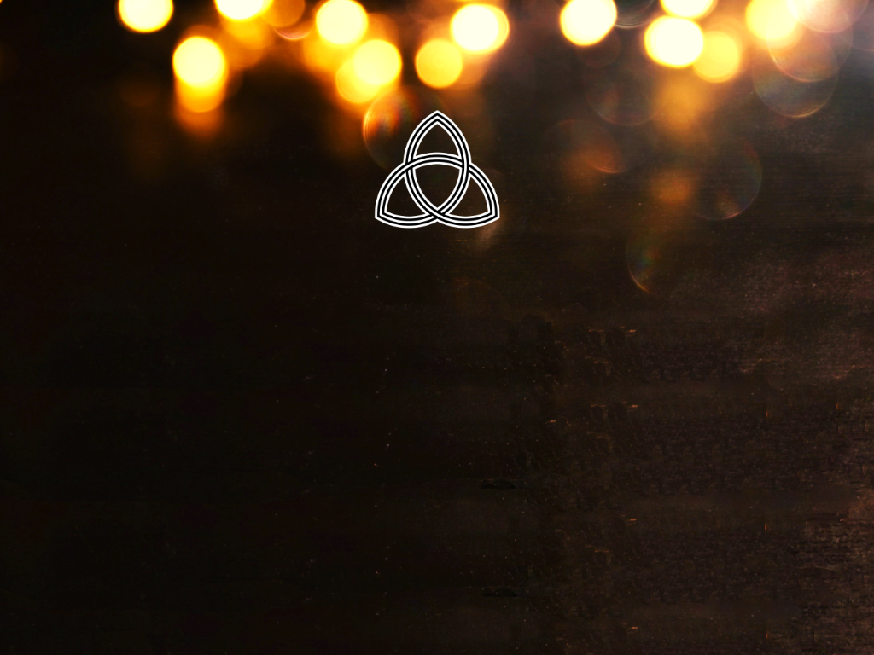

Slide 5
“In the beginning was the Word, and the Word was with God, and the Word was God.” – John 1:1

Slide 8
“All this took place to fulfil what the Lord had said through the prophet: ‘The virgin will conceive and give birth to a son, and they will call him Immanuel’ (which means ‘God with us’).” – Matthew 1:22-23

Slide 11
“[Mary] will give birth to a son, and you are to give him the name Jesus, because he will save his people from their sins.’”
– Matthew 1:21

Slide 14
”Being found in appearance as a man, [Jesus] humbled himself by becoming obedient to death – even death on a cross! Therefore, God exalted him to the highest place and gave him the name that is above every name, that at the name of Jesus every knee should bow, in heaven and on earth and under the earth, and every tongue acknowledge that Jesus Christ is Lord, to the glory of God the Father.”
– Philippians 2:8-11

