Slide 1
New Creations in Christ
2 Corinthians 5:17

Slide 2
Can I start over?

Slide 3
Creation
Re-Creation
De-Creation

Slide 4
Earth
Garden
f

Slide 5
Creation
Re-Creation
De-Creation

Slide 6
Flood Cycle
Creation
Re-Creation
De-Creation

Slide 7
Flood Cycle
Exodus
Cycle
Creation
Re-Creation
De-Creation

Slide 8
Flood Cycle
Exodus
Cycle
Creation
Re-Creation
Prophetic
Cycle
De-Creation

Slide 9
Jeremiah 4:23-26
“I looked at the earth, and it was formless & empty; and at the [skies] and their light was gone. I looked at the mountains and they were quaking . . . I looked, and there were no people, every bird in the sky had flown away. I looked, and the fruitful land was a desert.”

Slide 10
Flood Cycle
Exodus
Cycle
Creation
Re-Creation
Prophetic
Cycle
De-Creation

Slide 11
Isaiah 65:17
“Behold, I will create a New Heavens & a New Earth. The former things of the old creation will not be remembered”!

Slide 12
Flood Cycle
Exodus
Cycle
Creation
Re-Creation
Prophetic
Cycle
Jesus Cycle
De-Creation

Slide 13
You Can Be A New Creation
2 Corinthians 5:14-17

Slide 14
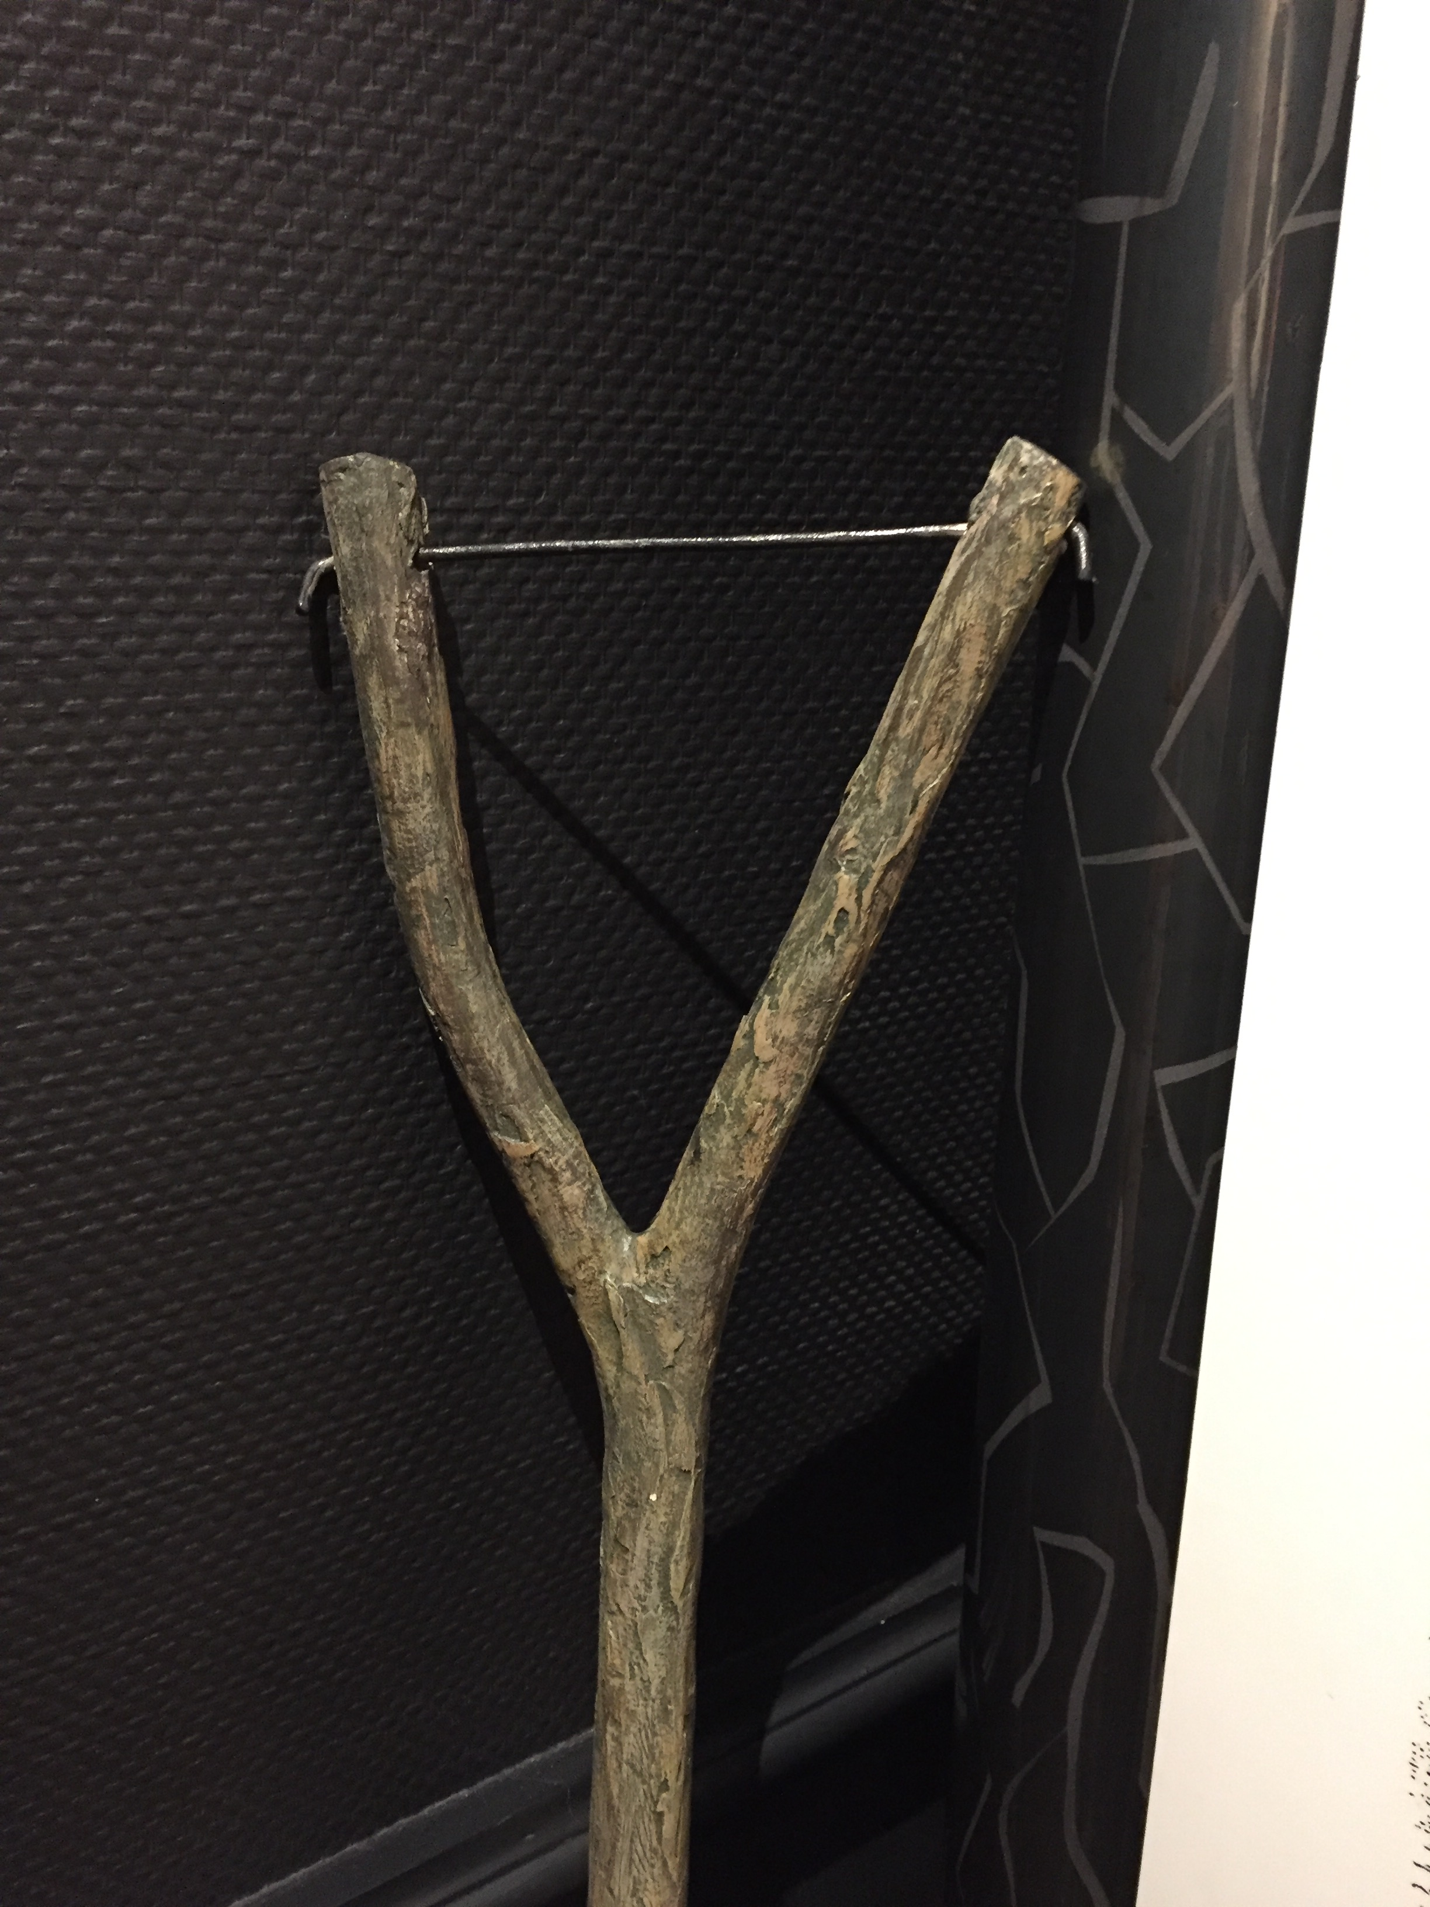
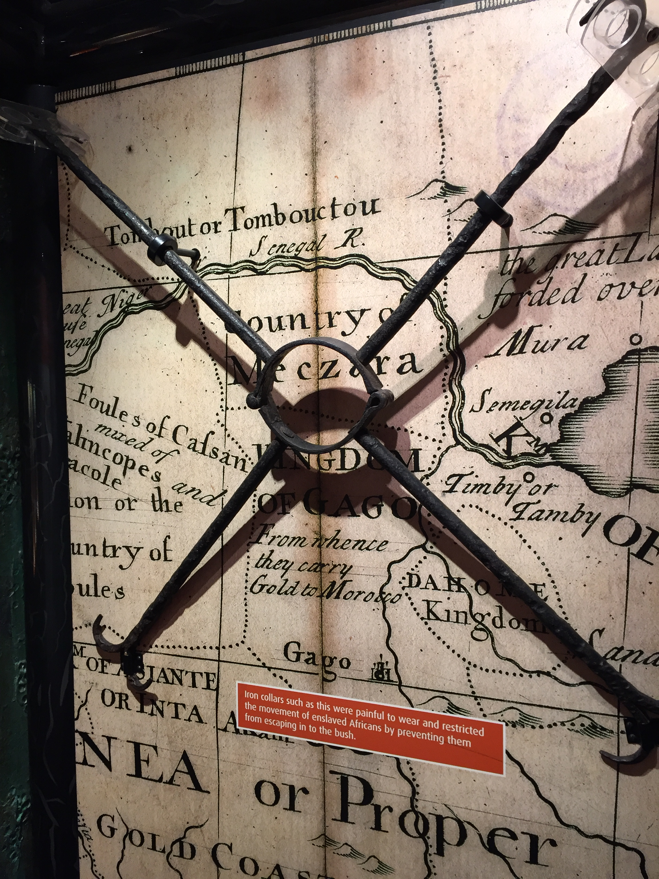

Slide 15
Isaiah’s View of the Future
FALL
Creation
Old / Decaying Creation
New Creation

Slide 16
FALL
New Creations in Christ
Creation
Old / Decaying Creation
New Creation

Slide 17
Three Questions about this New Creation:
Who?

Slide 18
Three Questions about this New Creation:
Who?
How?

Slide 19
Three Questions about this New Creation:
Who?
How?
Why?

Slide 20
You can start over.

