Slide 1
The Servant Song
Isaiah 52:13 – 53:3
“He Suffered”

Slide 2
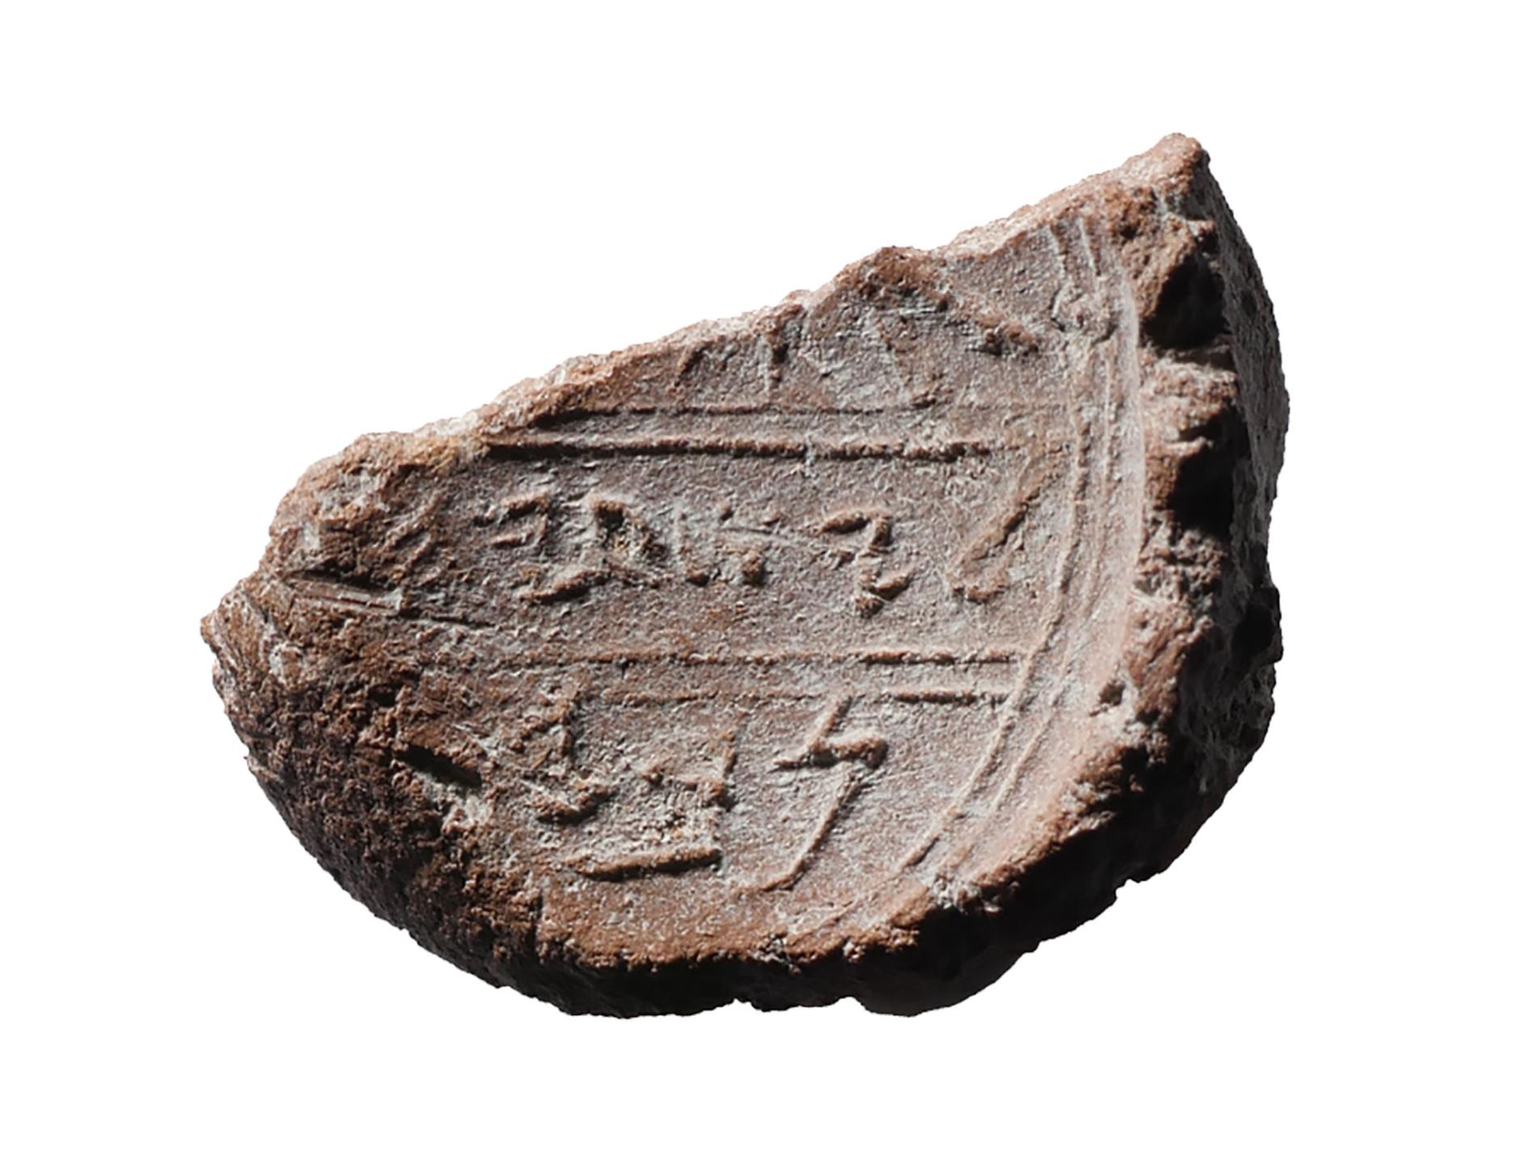
“Isaiah, the Prophet”

Slide 3
Two Sections
Isaiah 1-39
Isaiah 40-66

Slide 4
Who is the Servant?

Slide 5
The Song of the Suffering Servant

Slide 6
The Song of the Suffering Servant
The Servant:
Repulsive & Revered
Stanza 1: Isaiah 52:13-15

Slide 7
The Song of the Suffering Servant
The Servant:
Repugnant & Rejected
Stanza 2: Isaiah 53:1-3

Slide 8
Jesus: The Suffering Servant
Humble Beginnings

Slide 9
Jesus: The Suffering Servant
Despised & Rejected

Slide 10
Jesus: The Suffering Servant
“He Suffered”

